Slide 1

Memento Imago
Remember the Image
Narrative Report
Caerwyn Bartley

Slide 2
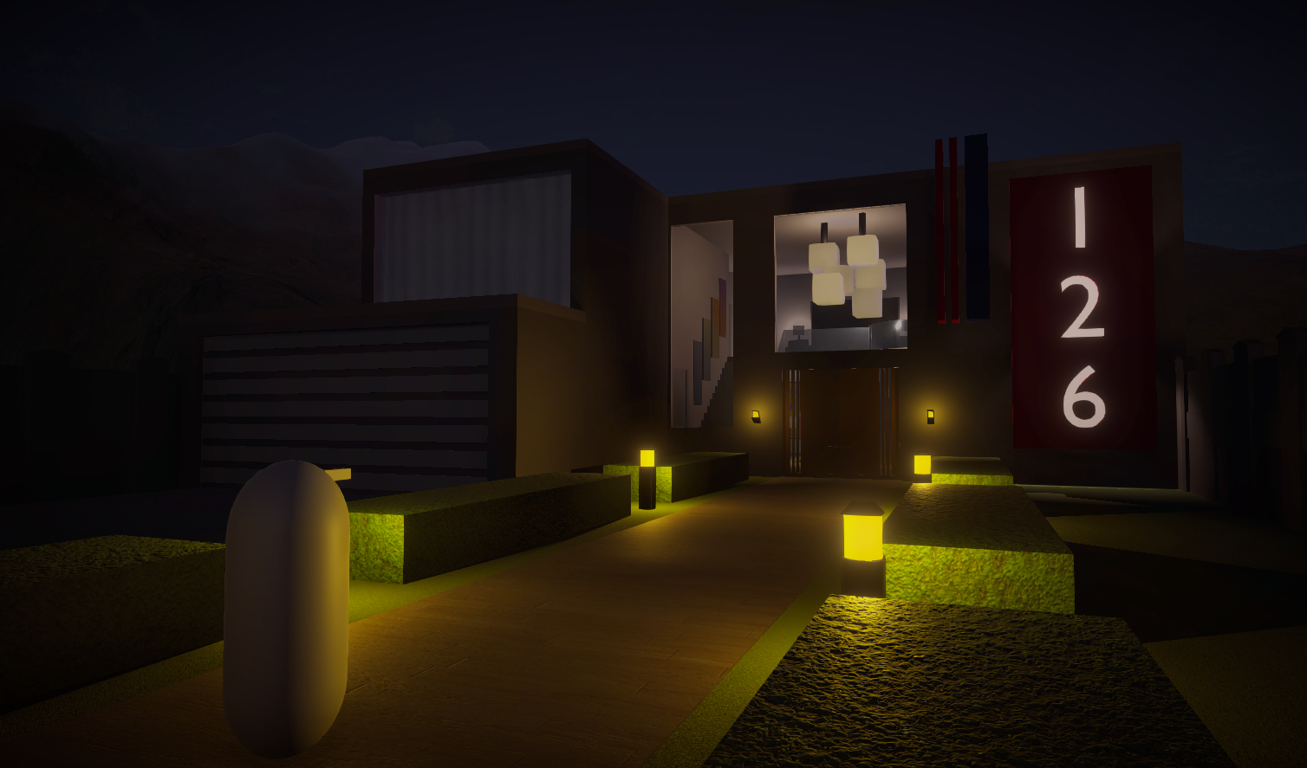
Narrative Description Synopsis
A new device called the visualization camera has been developed and is now being utilized in cold murder cases.
The player takes the role of a new detective in the year 2035 that has been assigned to the case of uncovering the murderer in a string of several killings that took place in the winter of 2033 by using photographs left at and in the crime scenes.

Slide 3
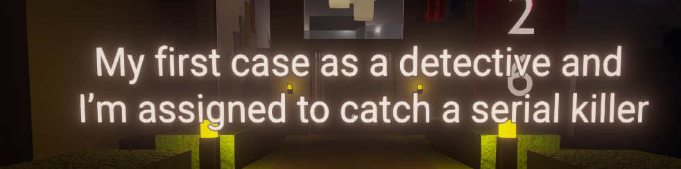
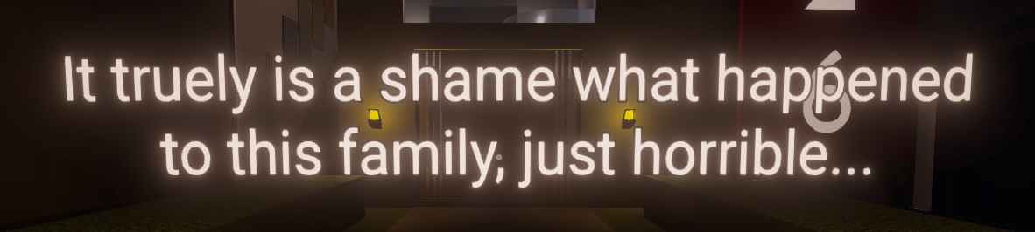
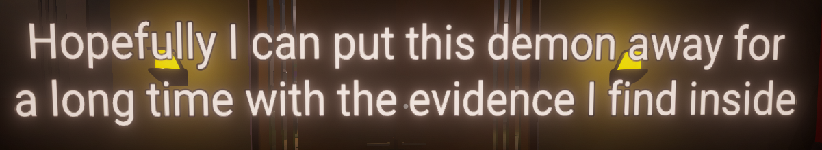
Narrative Description Walking into House Beat.
As the player walks into the house they are met with 3 pieces of text that convey to them why they are there and how the character they are playing feels about the events that took place.

Slide 4
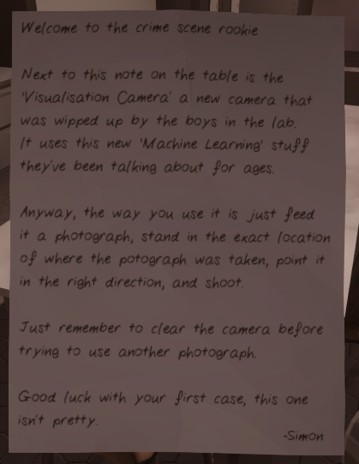
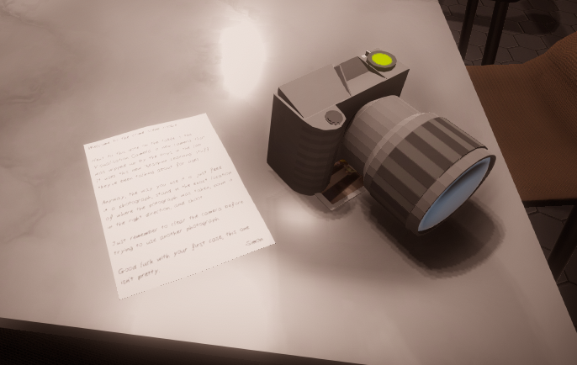
Narrative Description Gaining Visualisation Camera Beat
All the lights turn off and a light shines on the camera
There is a note left by one of the other explaining the visualization camera and how to use it
The visualization camera is on the kitchen table along with the player’s first photograph

Slide 5
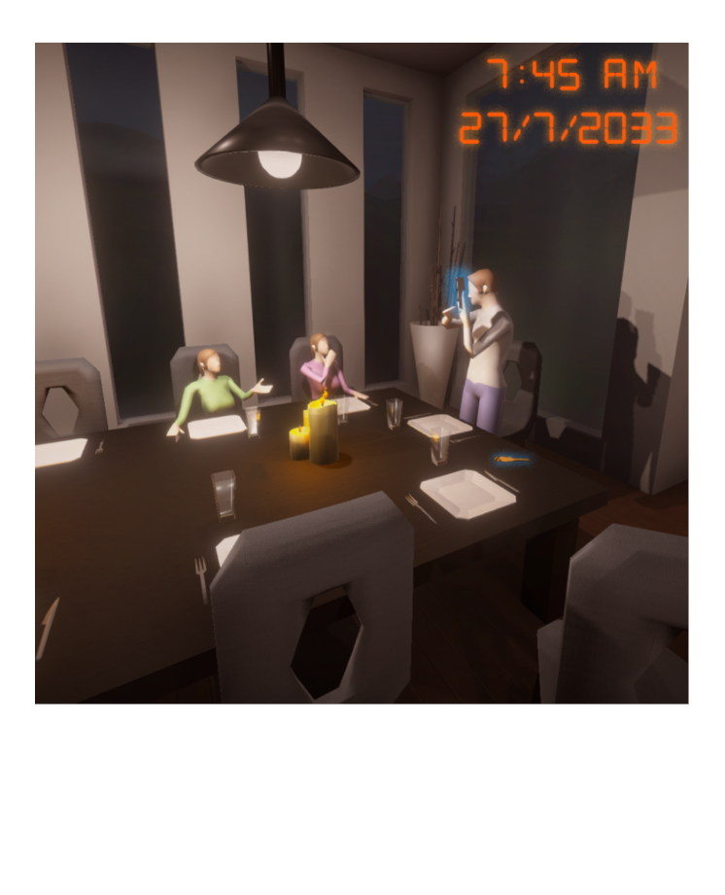
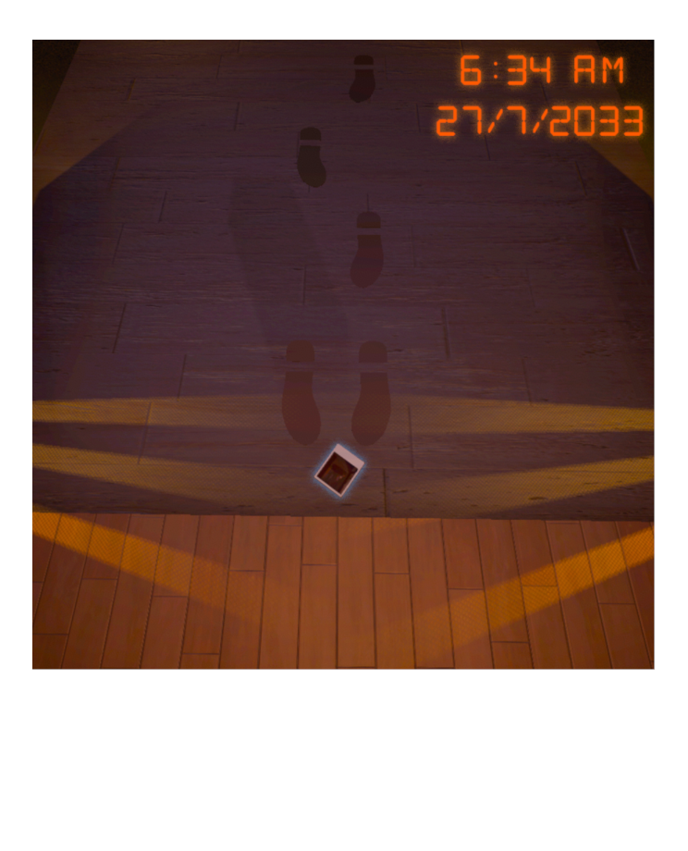
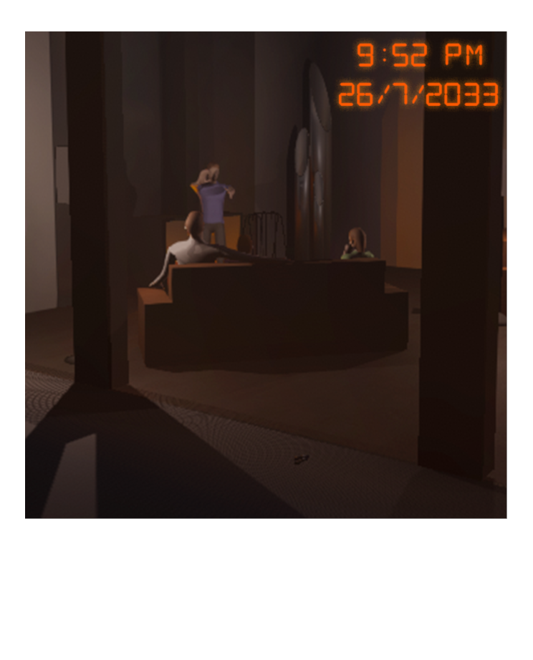
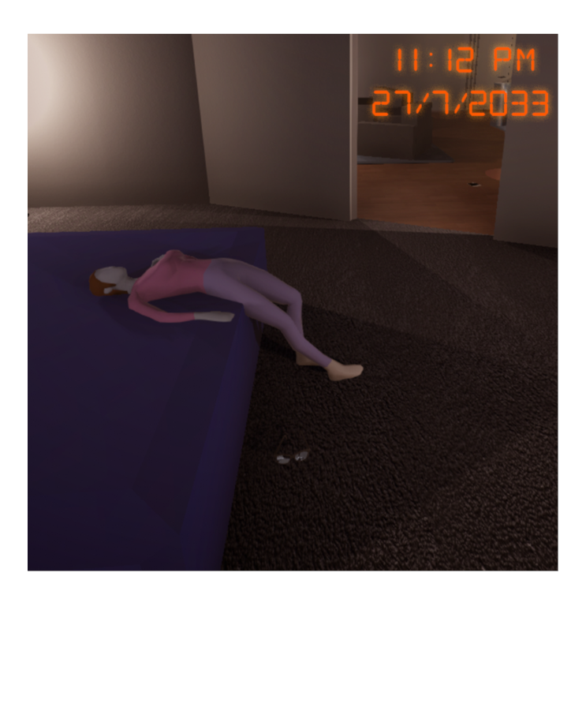
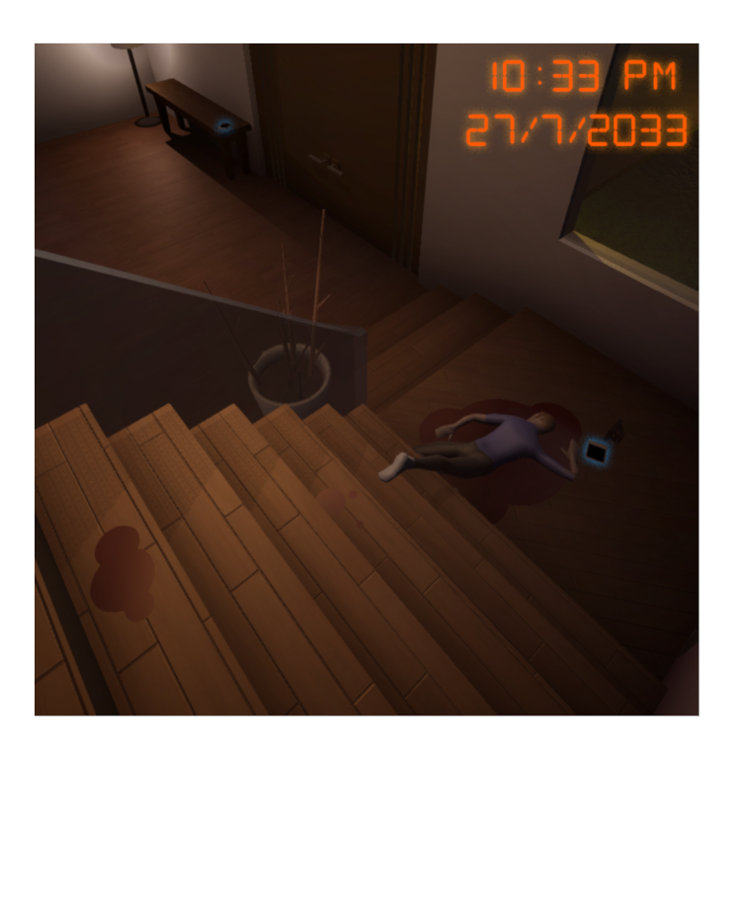
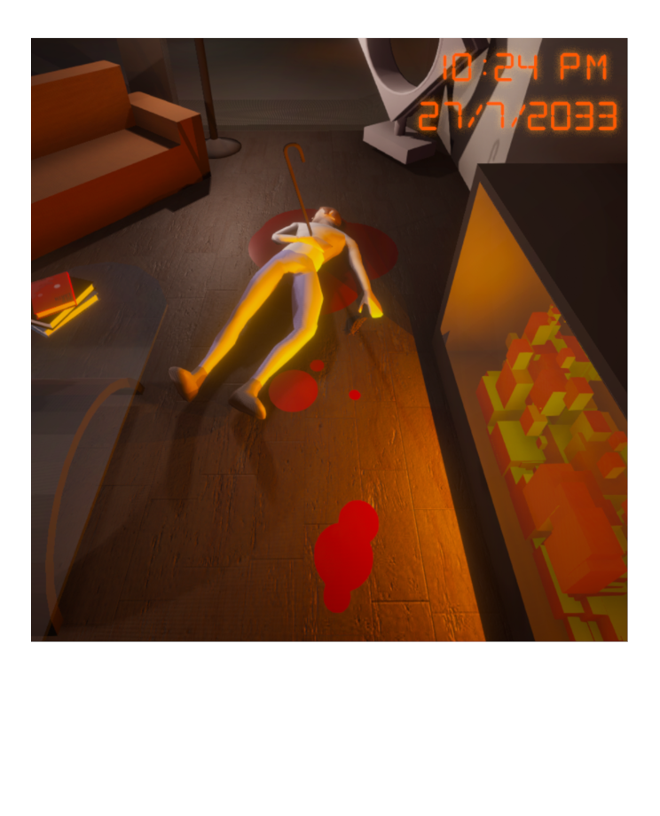
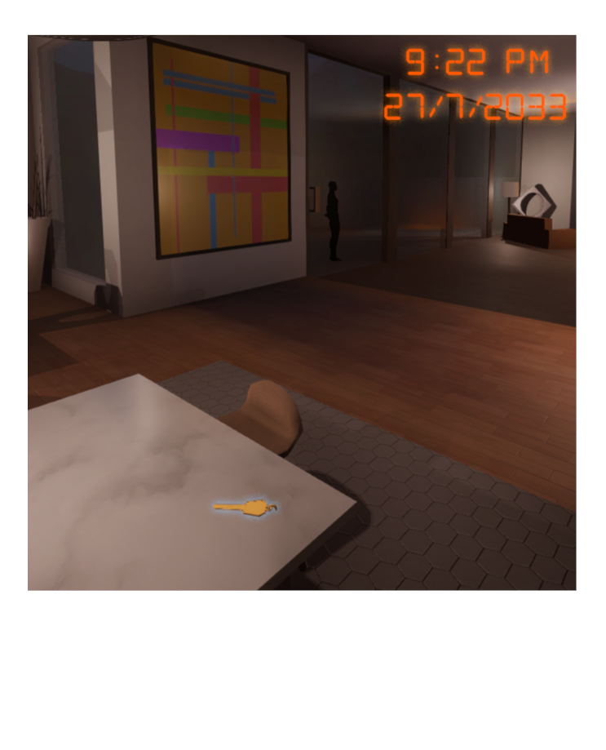
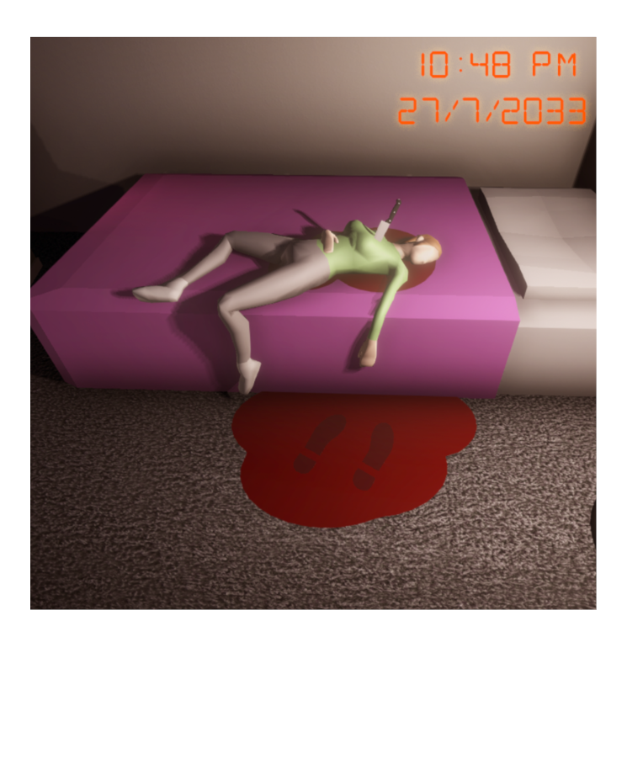
Narrative Description Investigation Beats
Enter Master Bedroom
Dinner Photograph
Muddy Footprint Photograph
Creepy Photograph
Unlock Son’s Bedroom
Mother Murder Photograph
Son Murder Photograph
Father Murder Photograph
Unlock Daughter’s Bedroom
Leave House
Shadowy Man Photograph
Daughter Murder Photograph

Slide 6
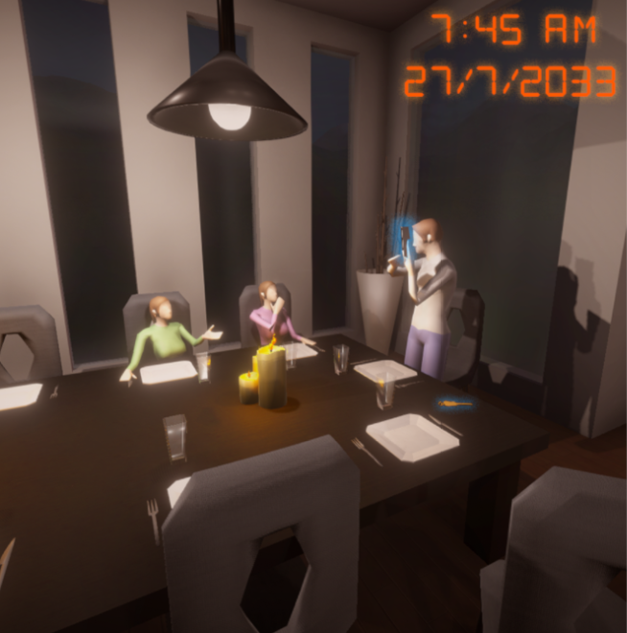
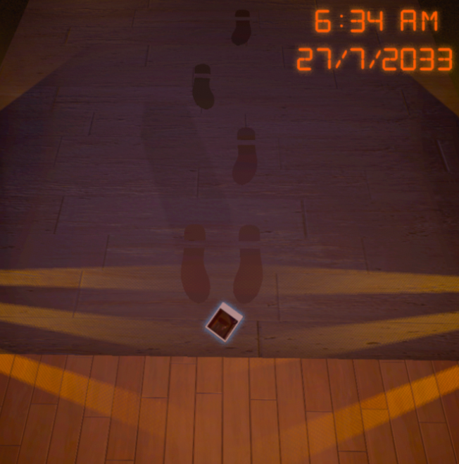
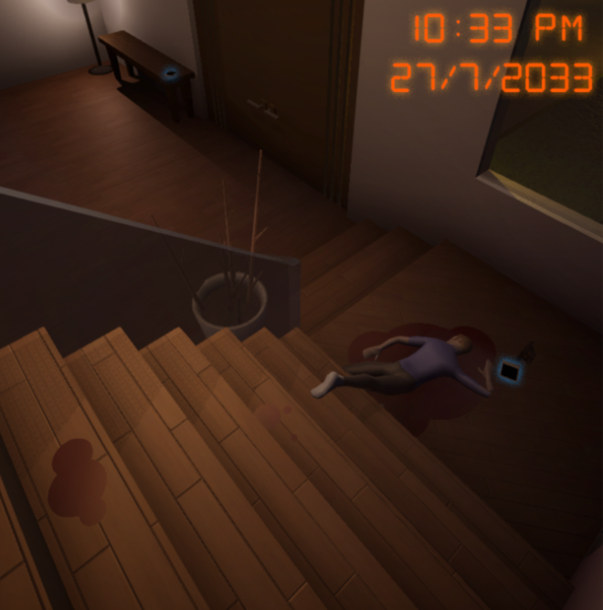
Iterative Design Iteration 1
I noticed that players in testing were constantly missing some of the photographs and important objects to progress with the story
To fix this I added a blue hue surrounding the pickupable objects in the photographs

Slide 7
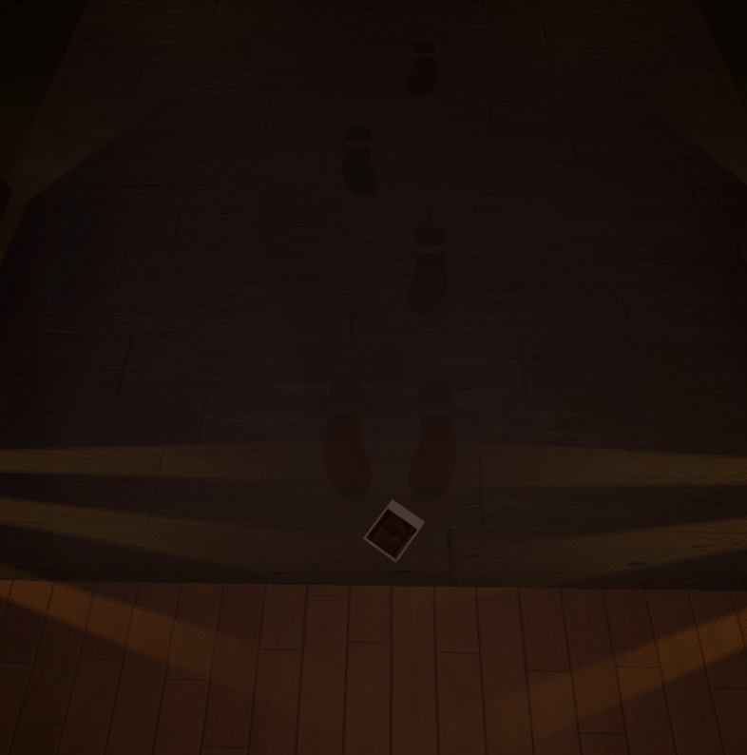
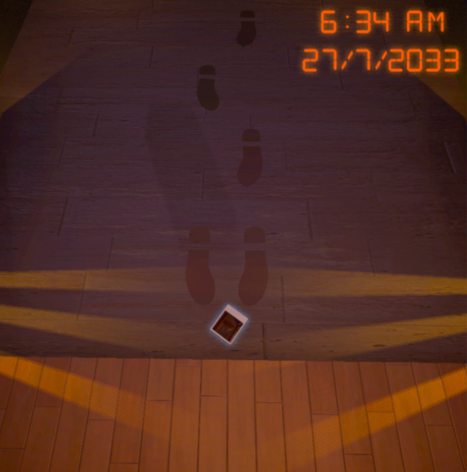
Iterative Design Iteration 2
I noticed that players in testing were having a hard time trying to see one of the photographs which was causing issues about trying to figure out where it is in the house
To fix this I increased the brightness of the image as well as added some small colour correction which led to players figuring out where they were meant to go faster and without struggle.

Slide 8
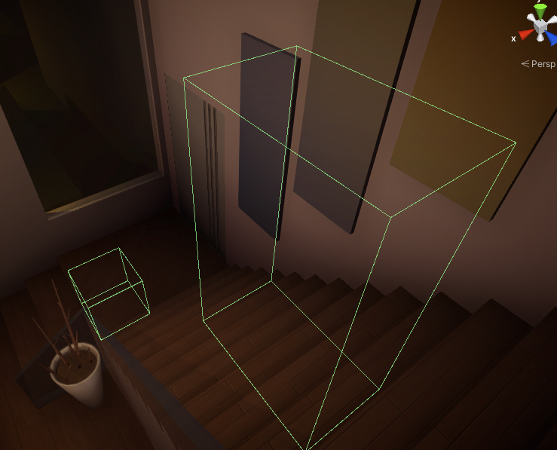
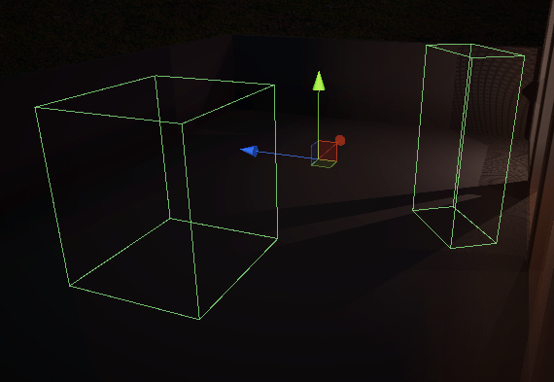
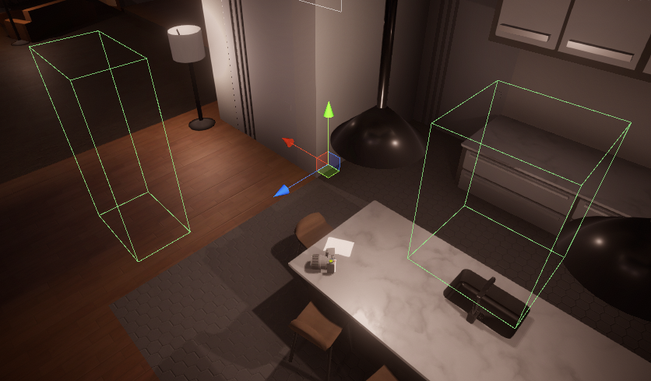
Iterative Design Iteration 3
I noticed that players in testing were having issues lining up some of the images in order to activate the visualization.
To fix this I increased the size of the trigger box as well as the range in which the player can look to activate the image which showed an instant improvement in future testing with how fast players were able to active them.

Slide 9
Iterative Design Feedback 1
Originally people testing the game were confused as to why they were there and what their purpose was at the crime scene
To Fix this I added some text that appears just before walking into the house that is from the mind of the character you are playing to help give some explanation.

Slide 10
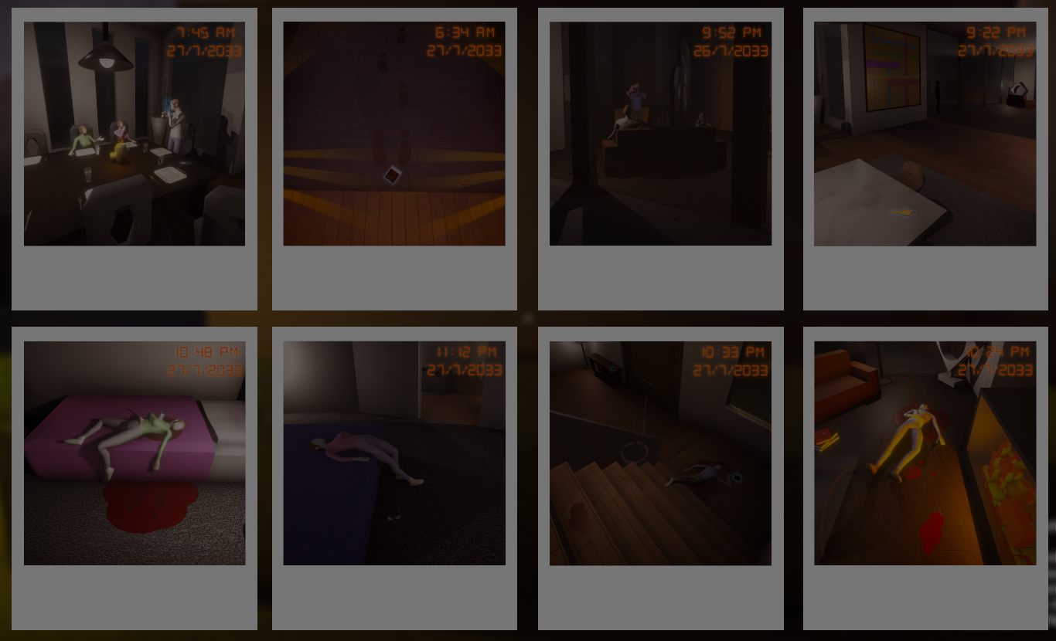
Iterative Design Feedback 2
People testing the game were originally confused with the series of events and how they connected together
To Fix this I added a timestamp to all of the photographs to assist in helping players uncover the story and the series of events.

Slide 11
Iterative Design Feedback 3
People testing the game were originally confused with how to use the visualization camera.
To Fix this I added a piece of paper that gave some information about the story as well as a run down on how to use the camera.

Slide 12
Self Review
I believe the narrative (after adding a few details to assist in its flow and how it was conveyed) was conveyed to the players in a way that explained it in an effective way with the use of show don’t tell.
I believe the key strengths are the visual story telling of the narrative with scenes being laid out in a way that doesn’t require any words to convey what happened to the family.

Slide 13
Self Review
The biggest shortcoming of the game is the lack of polish leading to several issues where players ended up having to do something more than once as they may not have been in the correct place or looking at the correct place for the visualization to active or the pickupable objects had issues with their colliders leading to players having to look around on the object to pick it up and sometimes even disregarding the object.
While the visual story telling was a key strength of the game, a change I would make to my approach moving forward would be to reprioritize how important the visuals were and add more detail to the scenes in order to convey them better than they currently are cause while a majority of play testers understood the story, some parts were misinterpreted that, while didn’t change the flow of the narrative, lead to some confusion in areas.

